Slide 1

IoT WATER QUALITY MONITORING SYSTEM
Department of Electronics and Communication Engineering
Internal Guide
Dr .V.NARAYAN GOUD Ph.D
Professor
PRESENTED BY:
M.MADHU SUDHAN -21MG1A04A5
J.JAGADEESH -21MG1A0496
S.ANIL KUMAR -21MG1A04B1
K.KALYAN BABU -21MG1A0498

Slide 2
CONTENTS:
Introduction
Existing Method
Drawbacks of The Existing Method
Proposed Method
Working Process
Tools
Block Diagram
Result
Advantages
Applications
Future Scope
Conclusion
Reference

Slide 3
Introduction
Traditional water testing is slow and manual. IoT transforms this with smart sensors (pH, turbidity, etc.) that continuously monitor water and transmit real-time data via Wi-Fi to cloud dashboards. This automated system provides instant alerts, reduces costs, and ensures safty water for drinking, agriculture, and industry—enabling proactive, data-driven decisions.

Slide 4
EXISTING METHOD
Present water testing relies on lab analysis of manual samples, causing delays, high cost, and limited coverage. Field test kits offer portability but lack of real-time data. This approaches rapid response to contamination, risking public health and ecosystem safety.

Slide 5
DRAWBACKS OF THE EXISTING METHOD
Slow Process
Maintance High
Less Accuracy

Slide 6
Proposed Method
The proposed IoT-based Water Quality Monitoring (WQM) system uses Wireless Sensor Network (WSN) technology to monitor water quality in real time. It collects data on turbidity, pH, and temperature via smart sensors, enabling efficient data acquisition and processing to address, global water pollution challenges.

Slide 7
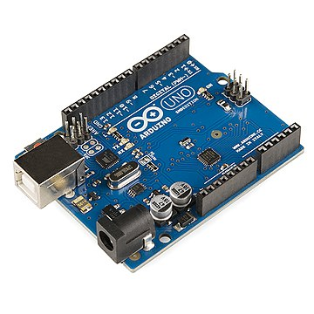
Hardware Components
Sensors
ESP 32 Microcontroller
Cables
LCD (Liquid crystal display)
Arduino Board
Arduino Board

Slide 8

SoftWarae Tools
Arduino IDE
Blynk app
Embedded C Language
Blynk app Icon

Slide 9
BLOCK DIAGRAM
POWER SUPPLY
(5V DC)
BUZZER
PH SENSOR
ESP 32
TURBIDITY SENSOR
LCD
TEMEPRATURE SENSOR

Slide 10
PH Sensor
A pH sensor measures the acidity or alkalinity of a solution by detecting hydrogen ion concentration. It’s used in water quality testing, agriculture, and labs for accurate, real-time pH monitoring.

Slide 11
Turbidity Sensor
A turbidity sensor measures water clarity by detecting suspended particles using light scattering or absorption. It's widely used in water quality monitoring, wastewater treatment, and environmental studies to assess pollution levels and ensure safe drinking water.

Slide 12
Temperature Sensor
A temperature sensor measures the temperature in an environment and converts it into an electrical signal.

Slide 13
ESP32
The ESP32 is a powerful, low-cost microcontroller with Wi-Fi and Bluetooth capabilities. Ideal for IoT projects, it features dual-core processing, ample GPIO pins, and supports various programming languages like Arduino and Micro Python.

Slide 14
Liquid Crystal Display(LCD)
An LCD (Liquid Crystal Display) is a flat-panel screen that uses liquid crystals to produce images. It’s energy-efficient, lightweight, and widely used in TVs, monitors, and smartphones for clear, bright visuals.

Slide 15
Buzzer
Buzzer is a signaling device that produces a buzzing sound, commonly used in alarms, timers, and quizzes. It operates electronically or mechanically, emitting a loud, attention-grabbing noise when activated

Slide 16
Working PROCESS
System Setup
The IoT water quality monitoring system uses sensors to measure parameters like pH, turbidity, and temperature. These sensors are connected to a microcontroller, which processes the data and transmits it wirelessly to a cloud server for analysis.

Slide 17
DATA COLLECTION
Sensors continuously collect real-time water quality data. The microcontroller reads these values, converts them into digital signals, and sends them to a gateway device via Wi-Fi, LoRa, or cellular networks for further processing

Slide 18
Data Transmission
The gateway device uploads the sensor data to a cloud platform. Secure protocols like MQTT or HTTP ensure reliable transmission, allowing remote access to the data from anywhere via web or mobile applications.

Slide 19
Cloud Processing
The cloud server stores and analyzes incoming data. Advanced algorithms detect anomalies, trends, or contamination risks, triggering alerts if water quality falls below safe thresholds.

Slide 20
User Notifications
If unsafe conditions are detected, the system sends instant alerts to authorities or users via SMS, email, or app notifications. This enables quick action to prevent health hazards.

Slide 21
Data Visualization
Users can access dashboards displaying real-time and historical water quality trends. Reports help in decision-making for water treatment or policy changes.

Slide 22
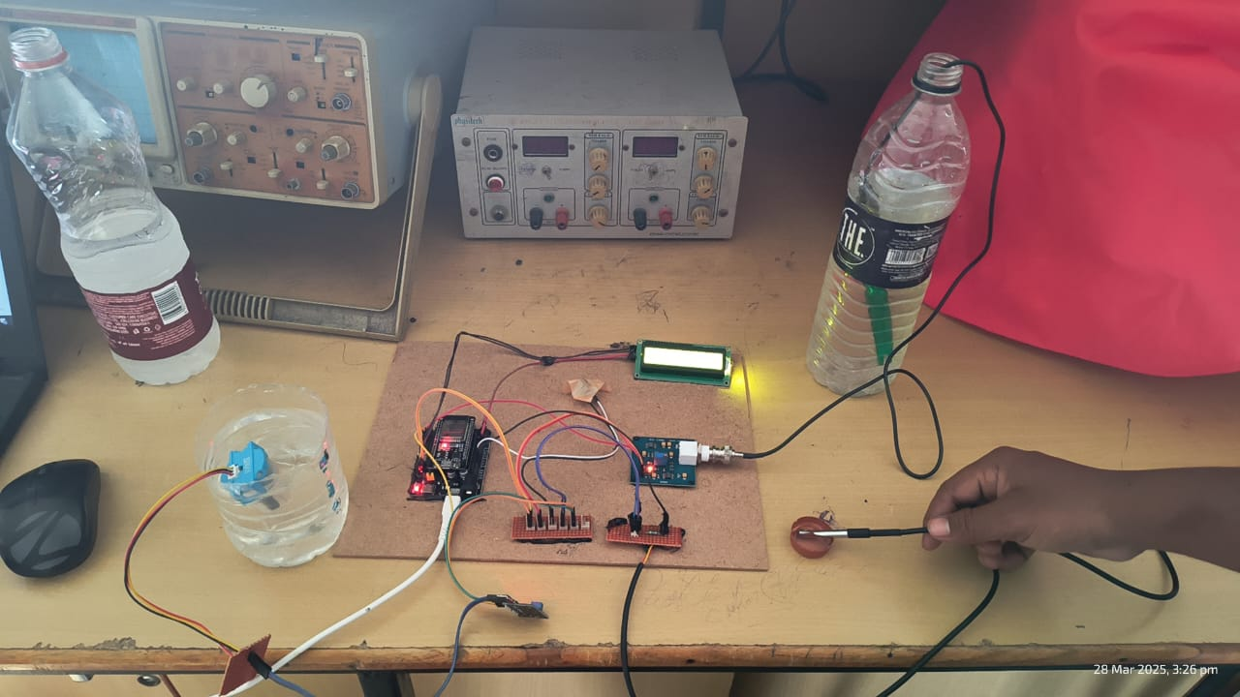
Circuit design
After connected each component Sensors and Acutors with controller esp-32.

Slide 23
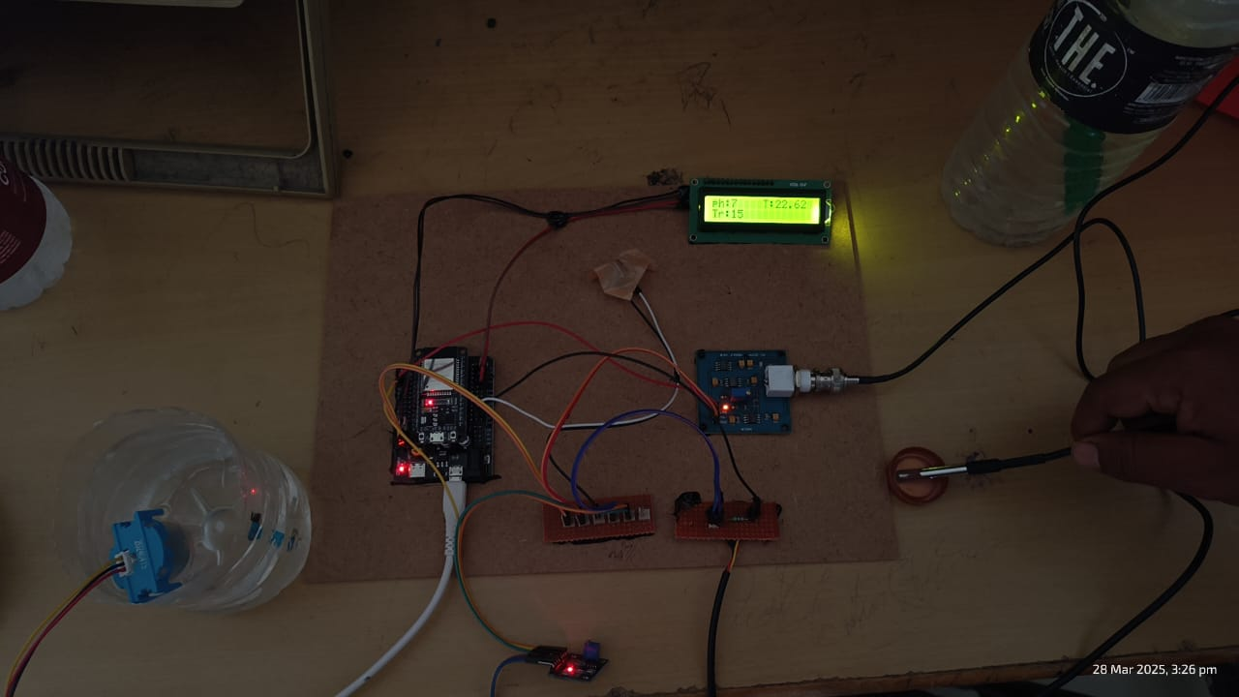
RESULT
Water Quality Monitoring with sensors

Slide 24
Results of Water Quality

Slide 25
Advantages
Remote Access
Cost-Effective
Sustainability
Early Pollution Detection

Slide 26
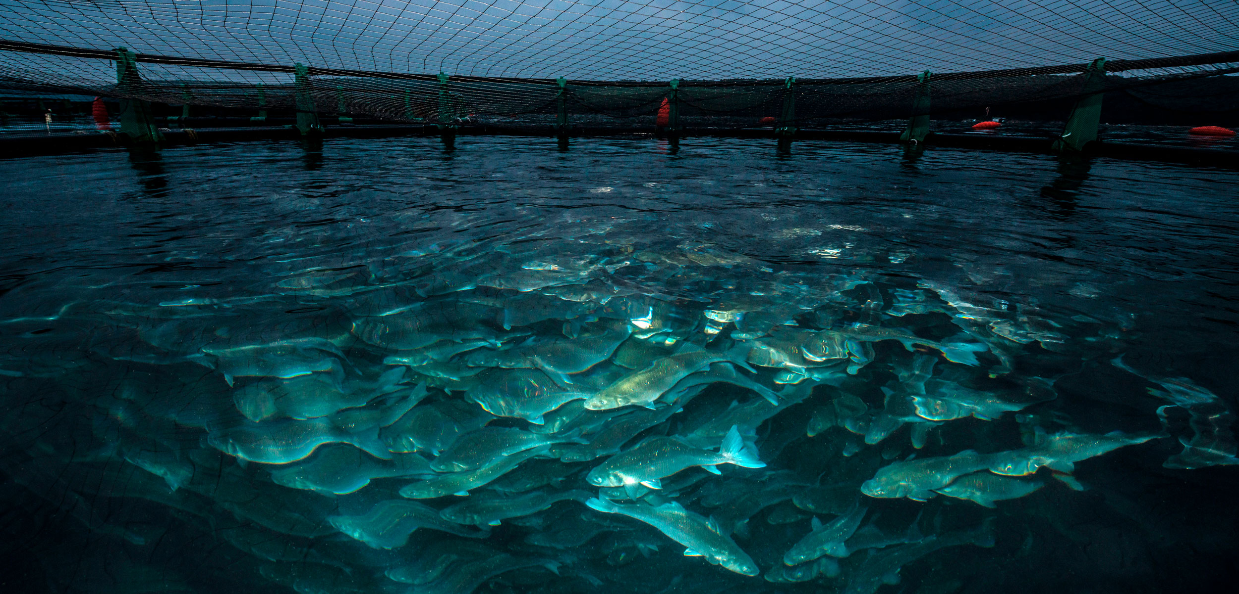
Applications
Drinking Water Safety
Aquaculture & Fisheries
Industrial Wastewater
Smart Agriculture

Slide 27
Future Scope
Future scope includes AI-driven analytics, real-time pollution tracking, multi-parameter sensors, IoT-cloud integration, mobile alerts, automated corrective actions, blockchain data security, and global scalability for smarter water management.

Slide 28
Conclusion
In conclusion, the IoT water quality monitoring project demonstrates the potential of smart technology to enhance water safety and management. By providing real-time data and analytics, it empowers stakeholders to make informed decisions, ensuring cleaner water sources, promoting public health, and fastering sustainable practices for future generations.

Slide 29
rEFERENCE
https://www.researchgate.net/publication/365220255_IoT_Based_Water_Quality_Monitoring_System
Mendez, G. R., et al. (2021). "Smart Water Quality Monitoring: A Review Using IoT and AI." Sensors Journal.
Gubbi, J., et al. (2013). "Internet of Things (IoT): A Vision, Architectural Elements, and Future Directions." Future Generation Computer Systems.
Kumar, S., & Jasuja, A. (2017). "Real-Time Water Quality Monitoring using IoT." IEEE International Conference on Smart Technologies.

Slide 30


